Slide 1
SafECO ®
by m10
The Most Effective
Complete Energy Saving Concept
In The Market Today

Slide 2
SafECO ®
by m10
FACTS -
Power Demand Is Forever Increasing
We “Sort Of” Learned That Global Warming Is Getting Serious
We Were Told That Oil/Coal/Gas Power Plants amongst Others Caused Air Pollution and Contributing To Global Warming
  Mining of Coal and Oil Releases Methane Gas
  Burning of Fossil Fuel Gives Off CO²
Majority Of Us Don’t Really Do Anything About It
  Lack of Knowledge
  Lack of Money
  Lack of Incentive
  Lack of Know How
  Lack of Will
If You Cannot Reduce, Don’t Increase
Let’s Saves Energy

Slide 3
SafECO ™
by m10
In The Building Environment,
An Effective Energy Saving Concept Should Be:
Effective Defense - Blocking The Heat From Entering The Premise, and
Strong Offence - Reducing The Energy Consumption With Smart Technology Systems
Effective, Affordable, Proven & Long Lasting
Good ROI

Slide 4
Group of Products
SafECO ®
Anti-Heat
Smart Technology

Slide 5
Group of Products
SafECO ®
MatriX+Opt
STJ
Energy Savings for Commercial
12V-DC WH
The Energy Saving Steam Trap
Energy Saving & Water Proofing
Anti-Heat Coating
Safety and Energy Saving
12V DC Water Heater
E² LED
KB90s
The LED Light Specialist
Energy Saving Window
Anti-Heat Coating
MS388
Energy Saving Wall/Roof
Anti-Heat Coating
Reduces Electricity Consumption
KB-WB
NSM
Energy Saving 12V DC
Mini Fridge
Non-Chemical Healthy Safe Food
Clean Water & Eco Waste Management

Slide 6

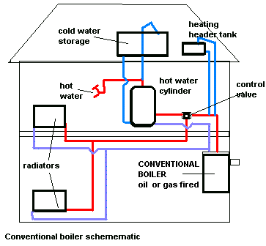
SafECO FOR WINDOW
REDUCE HEAT , 3 - 10° C
ENERGY SAVINGS
BLOCK 99.9% UV & >90% IR
NANO LIQUID GLASS
CENTRALISE A/C UNIT
THE COMPLETE-BLOCT ANTI HEAT AND ENERGY SAVING SYSTEM
SafECO FOR WALL & ROOF -
REDUCE HEAT , 10 - 30° C
ANTI-ALGAE
WATERPROOFING
NANO-TECHNOLOGY COATING
SafECO JST STEAM TRAP
ENERGY SAVING, 30 - 60%
COST EFFECTIVE,
DURABLE, > 5 YEARS
LOW MAINTANANCE
UV
IR
COATING ON PIPE TO REDUCE HEAT
HEAT
ROOF
WAREHOUSE / FACTORY
3 PHASE
MOTOR PANEL
A/C PANEL
OFFICE/MALL
SafECO OPTERGY SERIES -
Measure, manage & reduce
Real Time Data Collection
Building Dashboard & Visualization
Customized Reporting System
ENERY SAVINGS 20 - 40%
• Control, Tuning and Optimization
FACTORY / BOILER
SafECO MLS SERIES
FOR 3 PHASE MOTOR
PATENTED CONTROL SOFTWARE
> 30% ENERGY SAVINGS
SafECO NSM INCINERATOR
Stand-Alone Unit 1.5m² x 2.5m(H)
Can Handle 500-1000kg of Waste
Smoke-less
Dioxin from smoke is 0.68ng—TEQ/m3

Slide 7
SafECO - Complete-Bloc Anti-Heat System
KB90s for Windows
The Best Anti-Heat Liquid Glass Coating In The World!
SafECO ®

Slide 8
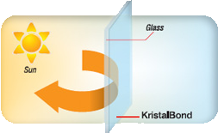

SafECO KB90s
Excellent Heat Blocker!
Comfort and Reduce Electricity Consumption
KB90s
KB90s is a liquid glass coating that cuts 90% of infrared ray (IR). Hence:
• Reduce air-conditioning usage & increase its efficiency
• Increase comfort, especially near glass areas
• Enjoy cooler & more comfortable living environment.
SafECO ®

Slide 9

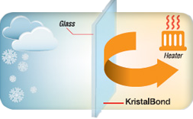
SafECO KB90s
Excellent Heat Insulator!
KB90s reduces heat loss from windows by retaining infrared generated indoor. It enables you to:
• Retain heat indoor
• Reduce cold draft and increase comfort
• Reduce condensation on windows
KB90s
SafECO ®

Slide 10

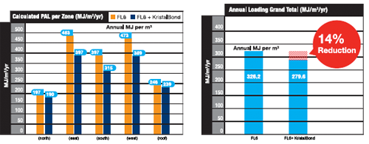
SafECO KB90s
Super Savings!
2-3ºC reduction in temperature can save up to 20% on electrical consumption
Reduce an estimate of 5.6kgm² /annum of CO₂ emmission.
SafECO ®

Slide 11
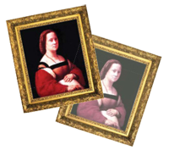

SafECO KB90s
Super Protection!
KB90s is formulated to block off 99 % of the sun's UVA and UVB to:
• Protect from skin pigmentation and skin cancer.
• Keep your furniture, displays and valuables from accelerated fading and ageing.
• Keep out insects that are attracted to UV emitting from indoor lights.
SafECO ®

Slide 12
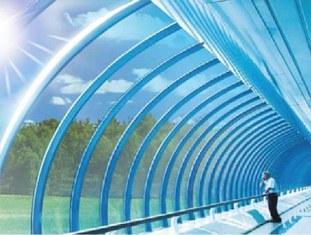

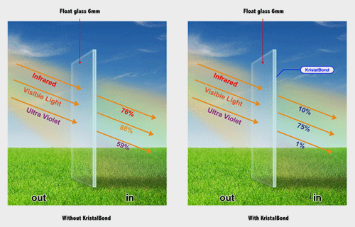
SafECO KB90s
Fulfill Your Designing Dream!
A colourless and ultra clear coating, KB90s reduces reflection on glass due to its crystal like nature.
Only 7 microns thin with a low haze level of 0.8, KB90s owes its super transparency to nanotechnology.
Colourless, KB90s preserves your window's originality, keeping it clear without any distortion.
SafECO ®

Slide 13
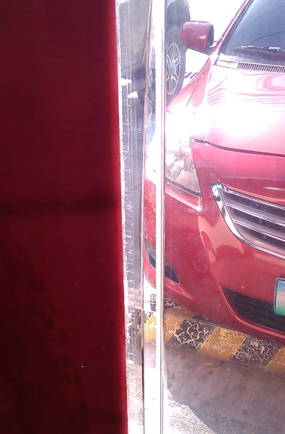

SafECO KB90s
Build To Last!
Smart Investment, Good ROI.
Lasting and Save Money!
With a 6H hardness, KB90s has a high scratch resistance, it does not peel, de-metalize or require special maintenance. It does not incinerate nor pose any toxic danger.
SafECO ®

Slide 14

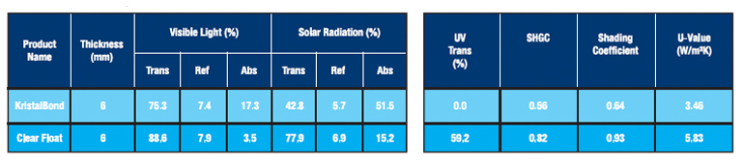
SafECO KB90s
Simply Flexible!
Any Size, Any Shape.
Shape & Size
KB90s is a glass in liquid form, can be coated on curved glass and large glass areas seamlessly for a perfect smooth finishing.
Its superior self levelling properties give KB90s the finishing edge over solar control films.
SafECO ®

Slide 15
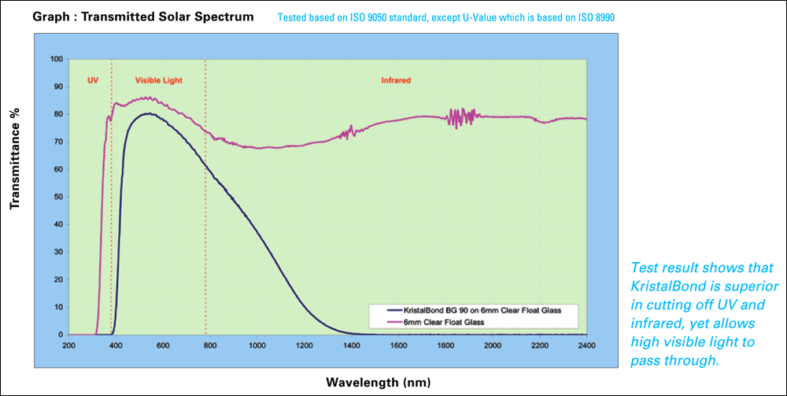
SafECO KB90s
Tested based on ISO 9050 standard, except U- Value which is based on ISO 8990.

Slide 16
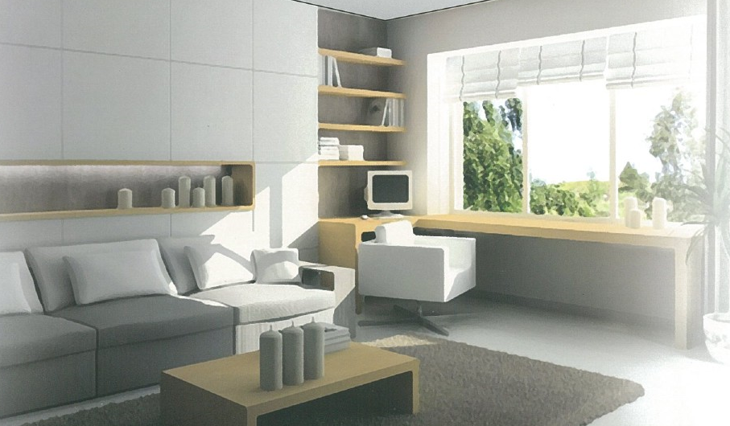
SafECO KB90s
How KB90s is different from other solar control products?
Compared to other reflective tint film & low-E glass, KB90s;
Does not create glare to other buildings
Does not trap heat in the city
Retain heat during winter
Does not have oxidation concerns such as de-metalizing
Retains a high visible light transmission for day light harvesting
Can be applied on selected glass panes particularly those facing East and West
Not fire hazardous
Patented in 16 countries
Warranty of 10 years!!!
SafECO ®

Slide 17
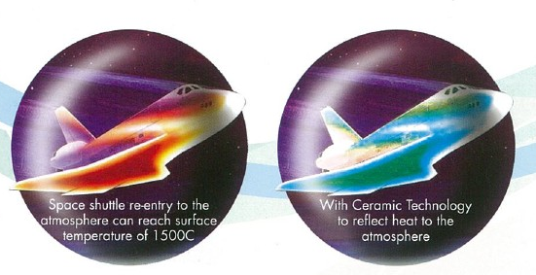
SafECO - Complete-Bloc Anti-Heat System
KBWB for Wall & Roof
The Space Shuttle Technology
Heat-Protection Wall Coating
SafECO ®

Slide 18
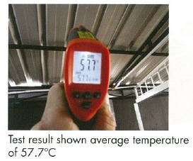
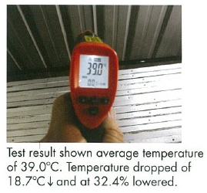
SafECO KB-WB
Just How Effective Is KB-WB?
Well, Numbers Don’t Lie!
Before KB-WB
After KB-WB
SafECO ®

Slide 19
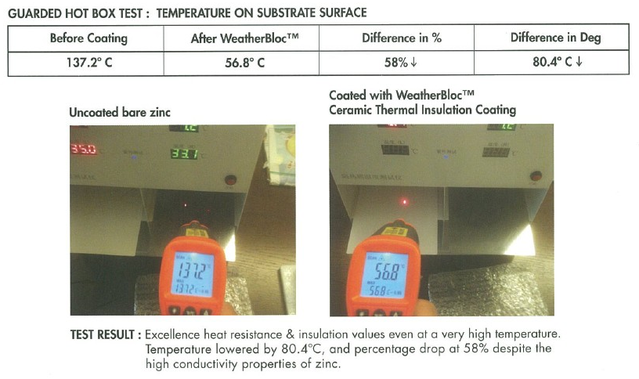
SafECO KB-WB

Slide 20
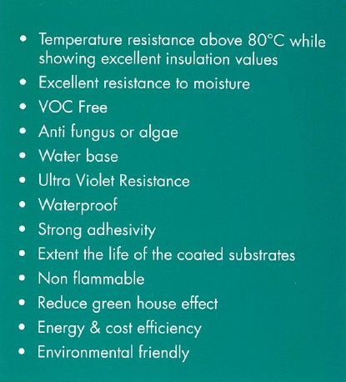
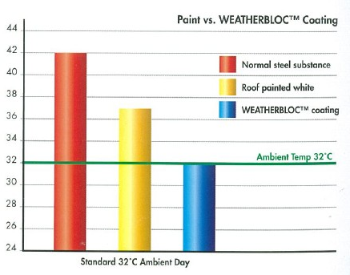
SafECO KB-WB
Formulated for our tropical climate
Insulating Ceramic Beads reflect radiant heat rays
Water based fluid-applied ceramic thermal insulation coating system

Slide 21
SafECO ®
by m10
The Smart Energy Saving Technology
Smart, Intelligent, State-of-the-art
Energy Saving Technology

Slide 22
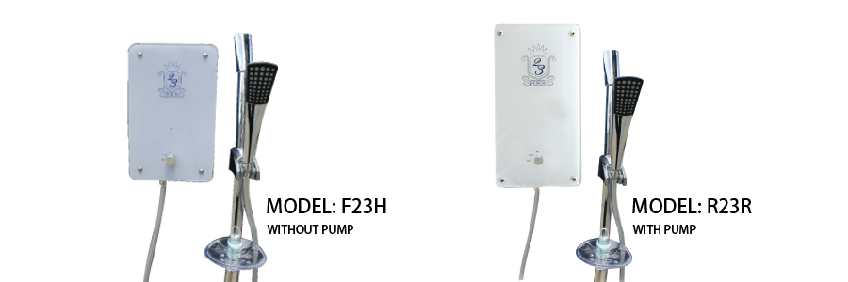
SafECO 12VDC Water Heater
Seers Eco Instant Water Heater
This is a low power consumption water heater.
Carefully designed for all household, hotels and any applicable vicinity.
User safety is utmost priority
First ever water heater without submersible electric heating coil.
Many patents and certification in design, invention and utility model.
SafECO ®

Slide 23
SafECO 12VDC Water Heater
Advantages
Safest!
No heating element
No worry of electrocution
Saves!
Low power consumption 2,000 watts VS 8,000 watts
Energy Saving up to 60%
Easy!
No more hassle of lying Copper piping
Easy installation
Runs on 12V DC, save cost
SafECO ®

Slide 24
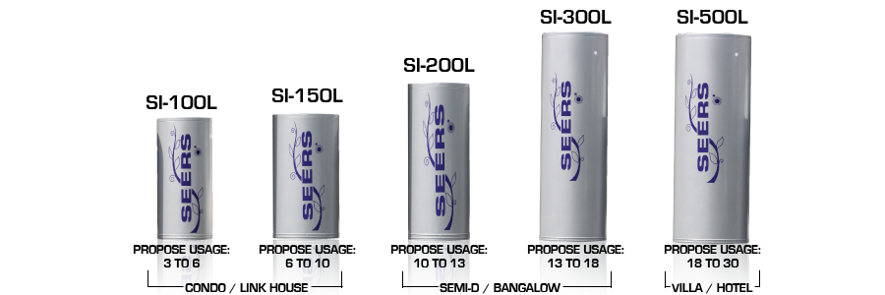
SafECO 12VDC Centralise Hybrid Hot Water System
SafECO ®

Slide 25
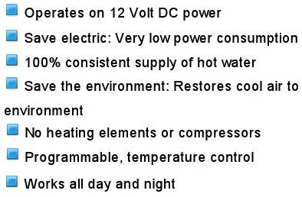
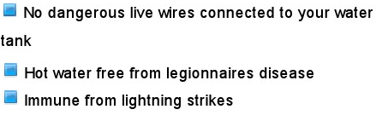
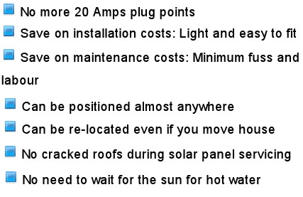
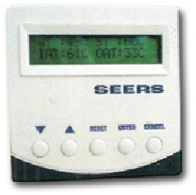
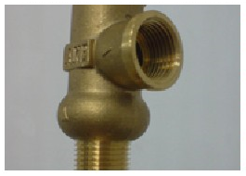
SafECO 12VDC Centralise Hybrid Hot Water System
Great Savings!
Safety is #1 !
Convenient and Cost Effective!

Slide 26
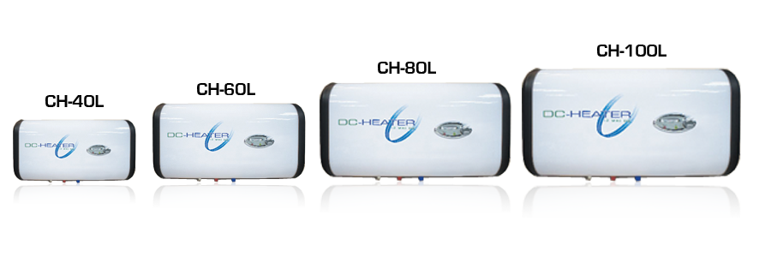
SafECO DC Strorage Hot Water System
Advantages
No heating element and no risk of electrical shock
100% hot water consistency
Adjustable temperature
Temperature indicator
Eco friendly
Save provision of cable
Dry run protection
Good insulation
480 watts with 60% of energy saving
High return of investment
SafECO ®

Slide 27

SafECO 3 Sec Thermal Flask
Save and Safe Hot Water
2.5 sec to boil water
Hot water on demand.
Energy savings, as high as 98%
Low operating cost
Temperature setting
Healthy water. No more re-boiling.
Safety auto shut-off
Low maintenance

Slide 28
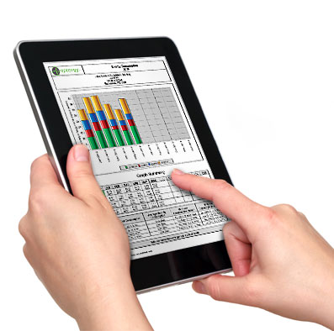
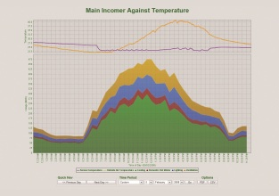
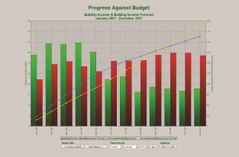
What Energy Management System-Optergy does?
by m10
Real Time Data Collection
Building Dashboard and Visualization
Customized Reporting System
Control, Tuning and Optimization

Slide 29
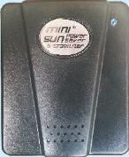
SafECO MS Energy Saving
No. 1 Selling Power Saving Unit in Asia!
Reduces power consumption by 10-20%
Plug and play. No wiring works.
Affordable, good ROI.
Suitable for houses, apartments, condominium, shops, offices, small factories etc.
2 years warranty

