Slide 1

The BIG C –
How Does It Affect Us
By: Sudhaharan Nair
General Manager
National Cancer Society Malaysia

Slide 2
What is the BIG C
CANCER

Slide 3
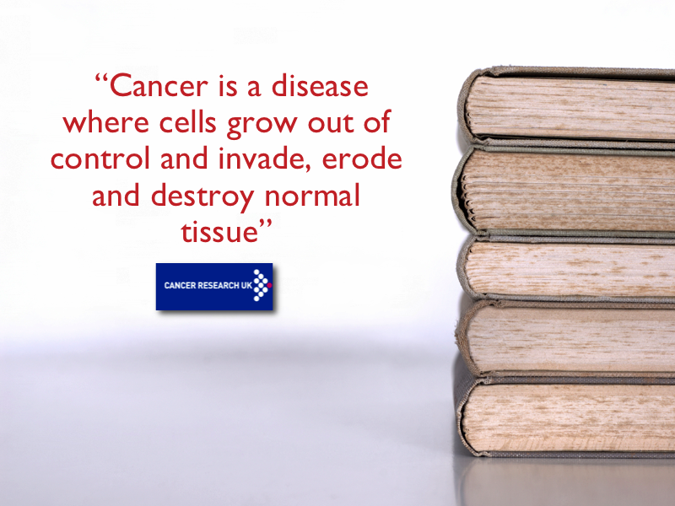


Slide 4

Normal body cells grow, divide and die in an orderly fashion.

Slide 5

Cancer cells are different because they do not die, they just continue to grow and divide in a disorderly fashion.

Slide 6
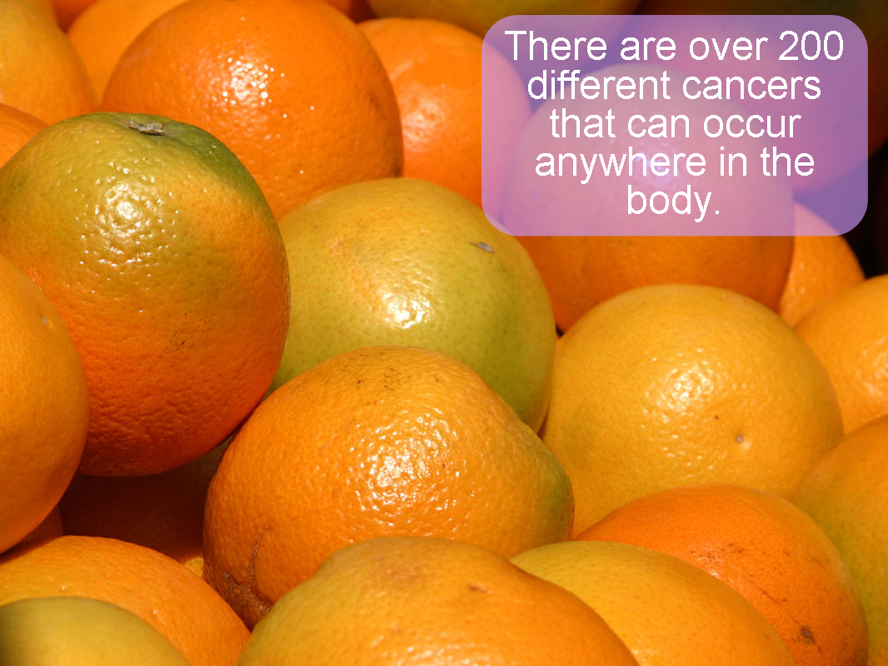

Slide 7
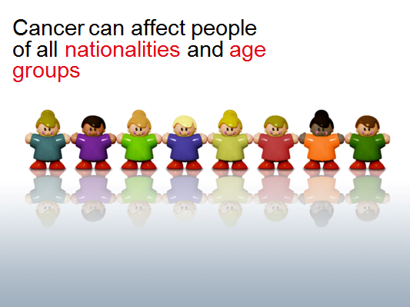

Slide 8
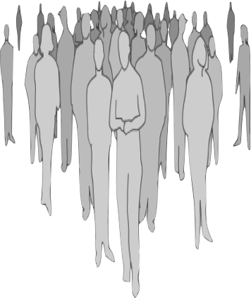
Cancer can occur at any age, but 67% cancer deaths occur in people older than 65 years

Slide 9




I Won’t Have Cancer Coz’…
Cancer won’t happen to me !
No one in my family has cancer
I have a healthy lifestyle
  I don’t drink alcohol….. I don’t smoke
  I eat healthy food….. I exercise regularly
I’m too young

Slide 10
I Won’t Have Cancer Coz’…
LAME REASONS !!!
Cancer won’t happen to me !
No one in my family has cancer
I have a healthy lifestyle
  I don’t drink alcohol….. I don’t smoke
  I eat healthy food….. I exercise regularly
I’m too young

Slide 11

Reality Check
1 in 4 Malaysians have a lifetime risk of developing cancer
Cancer happens at any age, sex or race
World Statistics:
12.7M new cancer cases & 7.6M cancer deaths reported annually – Globocan 2008
2030- 21.4M new cancer cases & 13.15M cancer deaths
2050-27M new cancer cases & 17.5M cancer deaths
Malaysian Statistics:
NCR Malaysia 2008-35,000 new cancer cases and 20,000 cancer deaths annually
Cancer related deaths had increased to 11.8% in 2010, compared to 7.3% in 1975. (Minister of Health, Malaysia)
Every 12 mins a person is diagnosed with cancer in Peninsular Malaysia

Slide 12


Slide 13
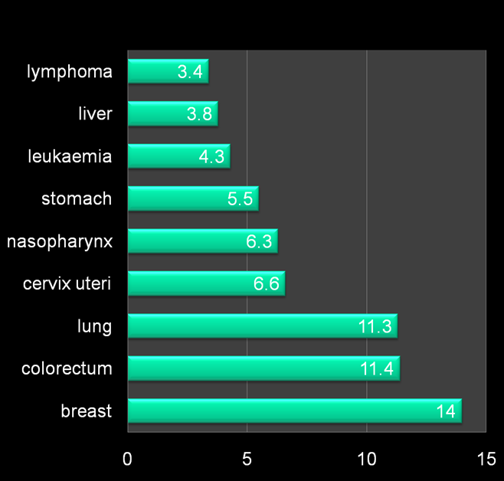
CANCER INCIDENCE IN MALAYSIA 2008
5 MOST COMMON CANCER IN MEN
Lung (17.5%)
Colorectal(13.1%)
Nasopharyngeal (9.6%)
Stomach(7.0%)
Liver(5.9%)
5 MOST COMMON CANCER IN WOMEN
Breast(26.5%)
Cervical(12.6 %)
Colorectal (9.9%)
Lung(5.8%)
Ovarian (5.4%)

Slide 14
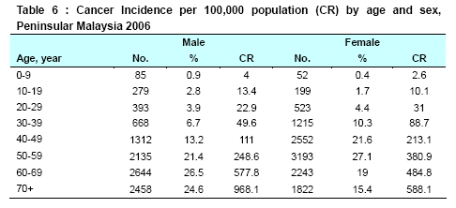
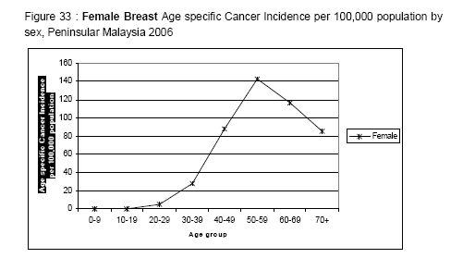
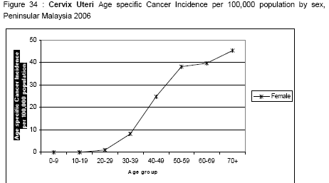
Notes:
Table 6: cancer can happen at any age – in men median age after 50 yrs; in women though 60% occurs between 30-60 years.
Fig 33: female breast cancer: 30-39 – 11%; 40-49 -30%; 50-59-34%
Fig 34: cervical cancer: 30-39 – 10%; 40-49-28%; 50-59 – 30%

Slide 15
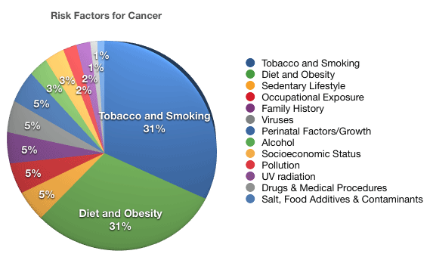
Cancer Risk Factors

Slide 16

Not just a pain in the butt……

Slide 17
What’s so bad about smoking?
It KILLS - Biggest preventable cause of death worldwide
It is the only LEGAL product that kills people when used as intended!
50% of all teenagers who smoke will eventually be killed from it
    One person dies of cancer every 5 minutes as a result of smoking

Slide 18




Unhealthy Diets

Slide 19

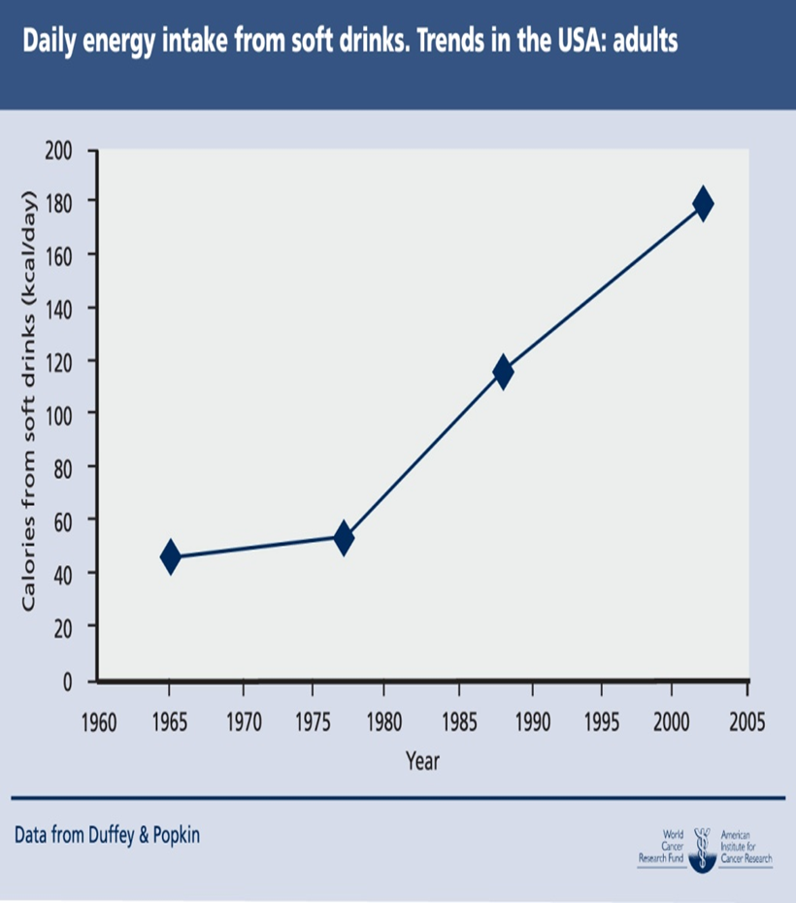

Slide 20



Lack of Physical Activity

Slide 22

What’s a healthy lifestyle?
Don’t start smoking or STOP if you already are
Be active
Eat healthy
Be Sun Smart

Slide 23
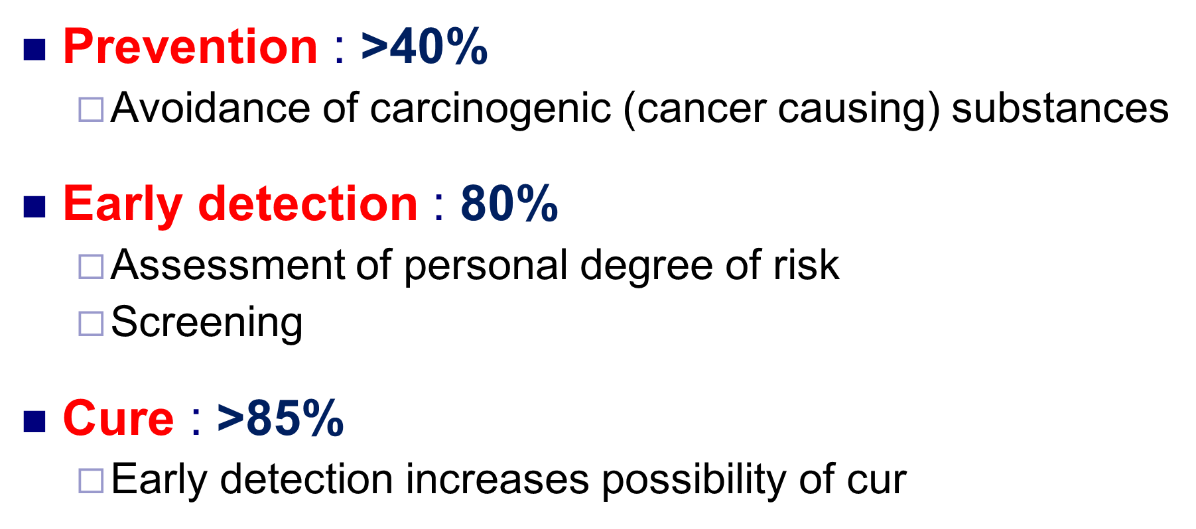
Importance of causes & risk factors?

Slide 24

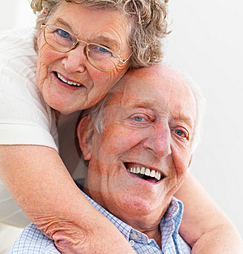

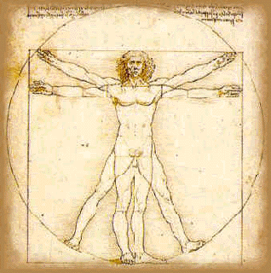


Impact of Cancer
mental
physical
emotional
financial
spiritual
Notes:
When you are told you have cancer, the diagnosis affects not only you, but also your family and friends. You may feel scared, uncertain, or angry about the unwanted changes cancer will bring to your life and theirs. You may feel numb or confused. You may have trouble listening to, understanding, or remembering what people tell you during this time. This is especially true when your doctor first tells you that you have cancer. It is not uncommon for people to shut down mentally once they hear the word "cancer."
There is nothing fair about cancer and no one "deserves" to have it. A cancer diagnosis is hard to take and having cancer is not easy. When you find out you have cancer, your personal beliefs and experiences help you figure out what the diagnosis means to you and how you will handle it. As you face your own mortality and cope with the many demands of cancer, you may look more closely at your religious beliefs, your personal and family values, and what's most important in your life. Accepting the diagnosis and figuring out how cancer fits into your life is challenging.
After you are diagnosed with cancer, you may feel shock, disbelief, fear, anxiety, guilt, sadness, grief, depression, and anger. Each person may have some or all of these feelings, and each will handle them in a different way.
Your first emotion may be shock, because no one is ever ready to hear that they have cancer. It is normal for people with cancer to wonder why it happened to them or to think life has treated them unfairly. You may not even believe the diagnosis, especially if you don't feel sick.
You may be afraid. While some people fear cancer itself, others may be afraid of cancer treatments and wonder how they will get through them. Fear of pain and suffering is one of the greatest fears people with cancer and their loved ones have.
You may feel guilty. You may ask yourself could you have noticed your symptoms earlier, or wonder what you've done that may have caused the cancer. You may wonder if you were exposed to something at home or work that led to cancer. Or you may worry that other members of your family will also get cancer. At this time we do not know what causes most cancers. But a few are known to be hereditary, or passed from a parent to a child. This means if one family member develops it, others in the family may have a higher risk of developing it, too. This can cause even more concerns for the person newly diagnosed with cancer.
You may feel hopeless or sad if you see cancer as a roadblock to a life full of health and happiness. It is hard to feel positive and upbeat, especially if the future is uncertain. Just thinking about treatment and the time it will take out of your life can seem like too much to handle. Feelings of sadness or uncertainty can be made worse by your experiences with cancer.
You may have a sense of loss linked to your cancer diagnosis and treatment. Cancer can change your sense of self, that is, how you think of your body, yourself, and your future. Grief is a normal response as you give up your old ideas of yourself and begin to develop ways to cope with the new, unwanted changes in your life. It may take time for you to become aware of these losses and changes. It can help if you share your grief with someone close to you. If there is no one near you that you want to confide in, you might want to see a mental health professional. Your feelings need care too, just like your physical body needs care.
You might feel angry. While some people may not outwardly express their anger and frustration, others may direct their anger toward family members, friends, or health care professionals. This is usually not done on purpose. If you are only trying to vent your feelings, let people know that you are not angry with them and know it is not their fault. Also let them know that you don't expect them to solve your problems--you just need them to listen.
Coping with your emotions
"The best prescription is knowledge."
-- C. Everett Koop, MD, former United States Surgeon General Some people believe it is easier to face the reality of a new or scary situation if they learn as much as they can about it. This is especially true when you are dealing with a complex group of diseases like cancer. There is often a great fear of the unknown and uncertainty about what is going to happen. Knowledge can help lessen the fear of the unknown. You can learn a lot about the type of cancer you have, its treatment, and your chances for recovery.
Be your own advocate. Even though people facing cancer cannot change their diagnosis, they can seek out reliable, up-to-date information and talk to family members, friends, and their health care team. Finding good sources of support can help people with cancer take control of their situation and make informed decisions.
It's important to work through your feelings about cancer, because how you feel can affect how you look at yourself, how you view life, and what decisions you make about treatment.

Slide 25
IMPACT OF A CANCER DIAGNOSIS

Slide 26
Psychosocial Needs
Common concerns of individuals with cancer on:
Self
Fear of recurrence
Physical symptoms e.g. fatigue, trouble sleeping, pain
Body image disruption
Sexual dysfunction and sexual attractiveness
Treatment related anxieties
Intrusive thoughts about illness / persistent anxiety
Feelings of vulnerability
Existential concerns regarding mortality
Self-care issues
Family & friends
Effect on family and friends
Risk of disease to family
Impact on work, daily activities and social life

Slide 27
Emotional
  Fear
  Denial
  Anger
  Guilt
  Acceptance
  People with cancer and their families may:
  Feel guilty about their emotional responses to the illness.
  Feel pressure to keep a positive attitude at all times. This feeling of pressure can come from within themselves or from other people in their lives.
  Sadness, depression, guilt, fear, and anxiety are all normal parts of learning to cope with major life changes -- a cancer diagnosis is a major life change.
  Trying to ignore these feelings or not talking with others about how you feel can make you feel lonely. It can also make the emotional pain worse.
Notes:
When you are told you have cancer, the diagnosis affects not only you, but also your family and friends. You may feel scared, uncertain, or angry about the unwanted changes cancer will bring to your life and theirs. You may feel numb or confused. You may have trouble listening to, understanding, or remembering what people tell you during this time. This is especially true when your doctor first tells you that you have cancer. It is not uncommon for people to shut down mentally once they hear the word "cancer."
There is nothing fair about cancer and no one "deserves" to have it. A cancer diagnosis is hard to take and having cancer is not easy. When you find out you have cancer, your personal beliefs and experiences help you figure out what the diagnosis means to you and how you will handle it. As you face your own mortality and cope with the many demands of cancer, you may look more closely at your religious beliefs, your personal and family values, and what's most important in your life. Accepting the diagnosis and figuring out how cancer fits into your life is challenging.
After you are diagnosed with cancer, you may feel shock, disbelief, fear, anxiety, guilt, sadness, grief, depression, and anger. Each person may have some or all of these feelings, and each will handle them in a different way.
Your first emotion may be shock, because no one is ever ready to hear that they have cancer. It is normal for people with cancer to wonder why it happened to them or to think life has treated them unfairly. You may not even believe the diagnosis, especially if you don't feel sick.
You may be afraid. While some people fear cancer itself, others may be afraid of cancer treatments and wonder how they will get through them. Fear of pain and suffering is one of the greatest fears people with cancer and their loved ones have.
You may feel guilty. You may ask yourself could you have noticed your symptoms earlier, or wonder what you've done that may have caused the cancer. You may wonder if you were exposed to something at home or work that led to cancer. Or you may worry that other members of your family will also get cancer. At this time we do not know what causes most cancers. But a few are known to be hereditary, or passed from a parent to a child. This means if one family member develops it, others in the family may have a higher risk of developing it, too. This can cause even more concerns for the person newly diagnosed with cancer.
You may feel hopeless or sad if you see cancer as a roadblock to a life full of health and happiness. It is hard to feel positive and upbeat, especially if the future is uncertain. Just thinking about treatment and the time it will take out of your life can seem like too much to handle. Feelings of sadness or uncertainty can be made worse by your experiences with cancer.
You may have a sense of loss linked to your cancer diagnosis and treatment. Cancer can change your sense of self, that is, how you think of your body, yourself, and your future. Grief is a normal response as you give up your old ideas of yourself and begin to develop ways to cope with the new, unwanted changes in your life. It may take time for you to become aware of these losses and changes. It can help if you share your grief with someone close to you. If there is no one near you that you want to confide in, you might want to see a mental health professional. Your feelings need care too, just like your physical body needs care.
You might feel angry. While some people may not outwardly express their anger and frustration, others may direct their anger toward family members, friends, or health care professionals. This is usually not done on purpose. If you are only trying to vent your feelings, let people know that you are not angry with them and know it is not their fault. Also let them know that you don't expect them to solve your problems--you just need them to listen.
Coping with your emotions
"The best prescription is knowledge."
-- C. Everett Koop, MD, former United States Surgeon General Some people believe it is easier to face the reality of a new or scary situation if they learn as much as they can about it. This is especially true when you are dealing with a complex group of diseases like cancer. There is often a great fear of the unknown and uncertainty about what is going to happen. Knowledge can help lessen the fear of the unknown. You can learn a lot about the type of cancer you have, its treatment, and your chances for recovery.
Be your own advocate. Even though people facing cancer cannot change their diagnosis, they can seek out reliable, up-to-date information and talk to family members, friends, and their health care team. Finding good sources of support can help people with cancer take control of their situation and make informed decisions.
It's important to work through your feelings about cancer, because how you feel can affect how you look at yourself, how you view life, and what decisions you make about treatment.

Slide 28
How to deal with it emotionally
Have a buddy – don’t do it alone
Types of support
  Spiritual
  Other survivors
  Support groups
  Friends
Express your feelings
Pay attention to yourself – do not give up control
RESILIENCE
Notes:
Bring a family member or friend along to appointments. They can serve as an extra pair of ears, help you remember things later, and give you support.
Ask for support from family, friends, and others. Just having someone who cares and will listen to you can be very helpful. If friends or family members are not able to be supportive, find others who will. Health care professionals (such as social workers, psychologists, or other licensed health professionals) and support groups can be extra sources of support.
Get spiritual support through prayer, meditation, or other practices that help you feel more at peace. You may want the guidance of a chaplain, pastor, rabbi, or other religious leader.
Pay attention to your physical needs for rest, nutrition, and other self-care measures.
Find ways to express your feelings, such as talking or writing in a journal.
Allow yourself private time and space.
Walk or exercise. It is a good idea to talk with your cancer care team about your plans before starting a new exercise program or activity.
Find out what helped other patients and families cope with cancer, and/or talk with other people diagnosed with the same type of cancer.
Make changes at home to create a healthier environment, and/or talk with your doctor about making healthy lifestyle choices.

Slide 29
Informed decisions
Is there time?
  Rush to get rid of the cancer
Learn about the cancer
  Sources of information
  Talking to doctors
  Feel comfortable with health team
  Work out treatment goals – may not always be cure
Analyse information sources
  Scientific base
  Complementary
  Alternative
  Make decision based on knowledge not emotions
Can revisit decisions/options as goals change
Notes:
People with cancer often feel the sooner they get rid of the cancer, the better. They may feel they need to make decisions right away. They may be concerned that extra tests and appointments with other doctors will take time that could be spent treating the cancer.
So how long is too long? Cancers grow at different rates. Most cancers do not grow very quickly, so there is usually time to gather information about your cancer, talk with specialists, and make a decision about which treatment option is best for you. Talk with your health care team if you are concerned about not starting treatment right away.

Slide 30
Telling Friends & family
Tell when u comfortable
Hard to hide diagnosis
Difficulty in expressing emotions
  Yourself
  friends
Valuable source of help and support
  Need to give guidance on how to help
  ‘well meaning friends’
Notes:
If you have been diagnosed with cancer, only you know the right time and the right words to use to tell your family and friends. You may find that sharing the news of what you are facing leads you to people who become key sources of support and encouragement. Sharing this experience with loved ones gives them a chance to offer their support. Your honesty and openness can help open new lines of communication and make relationships stronger and better.
It's very hard to hide a diagnosis of cancer. Friends and family might suspect you have cancer when they become aware of symptoms or different types of tests you have had. Often when people do not know what's going on, they imagine the worst possible situation. But when you do share the news, they may still be stunned and not know how to react or what to say.
Before you talk to others about your illness, think about your own feelings, your reasons for telling others, and what you expect of them. Be ready for a wide range of reactions. When you share information about your diagnosis, your family and friends will have many different feelings, too. They also need support at this time. They might be able to express their feelings to you, or they may try to hide them.
Each person reacts and copes differently when they learn someone they care about has been diagnosed with cancer. You may find that family members and friends are ready to talk about the cancer before you are. But no one should rush you. Simply thank them for their concern, and tell them you are not ready to talk about it yet.
Some family members or friends may feel uncomfortable talking about cancer. You may notice changes in how people act around you after you tell them the news. People may feel uncomfortable because they do not know what to say or how to act. This is new for you and for them, too. Not everyone has faced cancer before, and even those who have might not know anything about the kind of cancer you have or its treatment. Some friends may act awkward and distant, while others will continue to be themselves. Some may even seem to be too nosey or overly helpful. It will take time for all of you to adjust to cancer and get more comfortable talking about it. With time most people are able to share understanding, compassion, and friendship. Giving your loved ones information and a chance to ask questions can be helpful as you work through this time together.

Slide 31
Telling a loved one they have cancer
When to tell?
Keeping it a secret?
Changes in family dynamics
  New responsibilities
  Caregivers
  Stress on children
Notes:
Sometimes family members are the first to learn of a loved one's cancer diagnosis. How does a family decide if they should or when they should tell the person who has the cancer? Are some people too emotionally fragile, too young, or too old to know? Most people can handle the news that they have cancer, but each person needs time to adjust and figure out what the diagnosis means to them.
If you are a family member trying to decide if you should tell a loved one they have cancer, consider this: you may think you are sparing them bad news, but they probably will sense something is wrong, especially if they start having a lot of tests done and/or don't feel well. The person with cancer may resent it when they find out family members kept the diagnosis a secret. Although you may think you are protecting them, that person might see this as dishonest.
When people with cancer are not told about their diagnosis, they are unable to make important decisions about their treatment and their life. There may be things they want to do, personal matters they want to take care of, or legal papers that may need to be updated. Even when a person has a cancer with a good outlook, families still need to discuss decisions about end-of-life care, including advance directives (living will and durable power of attorney for health care).
A diagnosis of cancer changes a family forever. Figuring out what's for dinner or what your plans are for the weekend is suddenly less important. Family and personal values are questioned and priorities are tested and changed. Unsettled feelings and arguments may resurface during a family's struggle with cancer. Often a family must sort out and revisit old, unresolved feelings before they can start to battle cancer together, as a family unit.
Cancer can cause role changes in the family, too. The head of the household may now be more dependent on other family members. Others may need to work outside the home or work different hours. When family members take on new roles, the way they interact within the family can change. New responsibilities may overwhelm some family members.
Parents might look to their children for support. If the children are old enough, they may be asked to take on more responsibilities within the household. These requests often come when children themselves need support. The behavior of younger children might regress in response to the stress on the family. This may be their way of dealing with cancer and how it has changed their family. Adolescents, who are often rebelling and spending more time with friends, may instead cling to their families for support.
As a friend or family member helping to take care of the patient, you also have needs. Taking care of yourself will allow you to care for others. When your needs are met the patient will also benefit. Overdoing is different from doing. Know your limits and rest when you need to. This rule applies to both caregivers and patients.

Slide 32
Economic
Financial implications
  How to pay
  Insurance
Work
Balancing cancer treatment costs with life responsibilities
  Most expensive treatment may not be the best option

Slide 33
Financial & Non-Financial Aid
Common concerns on financial and medical needs:
Treatment too expensive; not enough money to cover cost
Money need to be spent on other family needs
Do not know where to get financial assistance
Do not know where to get assistance for equipment / medical aid

Slide 34

At least half of all cancers can be prevented with a healthy lifestyle
Over 80% of cancers found early can be cured

Slide 35
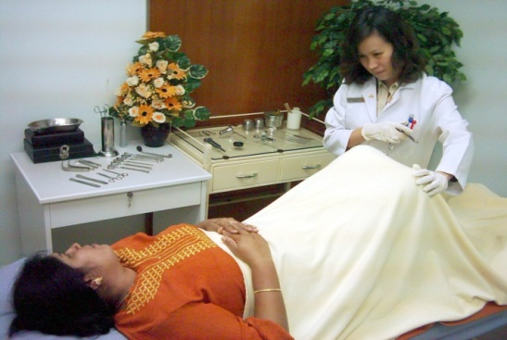
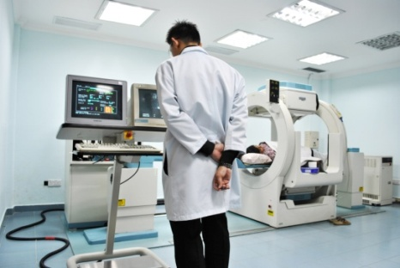
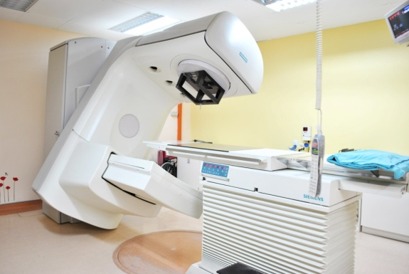


NCSM’s Services
EDUCATION,PREVENTION & RISK REDUCTION,SCREENING & EARLY REDUCTION, STAGING & MONITORING,DIAGNOSTICS,TREATMENT,SURVIVORSHIP CARE, PALLIATIVE CARE,ADVOCACY,RESEARCH
REDAUCTIONA
Cancer & Health Screening Clinic
Nuclear Medicine Centre
Cancer Treatment Centre
Resource & Wellness Centre
Children’s Home of Hope

Slide 36
NCSM’s Support Services Programs
Community Outreach
Purpose – Ensure that supportive services and prevention and early detection opportunities are provided to cancer patients and their families.
Supportive services
Cancer care is composed of a spectrum of services, ranging from prevention and early detection, through diagnosis and treatment, as well as end-of-life care. Support services include a variety of services and resources that help patients and their families deal with the diagnosis of breast cancer. Support services address the physical, psychological, emotional, financial, social, and spiritual needs.
NCSM recognizes the importance of addressing the cancer-related patient needs by providing / will provide the following support services, including (but not limited to):
Community resource list
Educational programs
Physical Therapy - Exercise Programs
Financial counseling
Support groups – chatline, hotline, emotional & psychological counseling for cancer patients and their families
Transportation services
Special services directed to children of cancer patients

Slide 37
Prevention and Early Detection
Programs
Prevention programs identify early risk factors and use strategies to modify attitudes and behaviors to reduce the chance of developing cancer. Early detection programs apply screening guidelines to detect cancers at an early stage, which improved the likelihood of cancer survival and decreased morbidity.
Prevention programs include, but are not limited to, the following:
Education / cancer awareness
Smoking cessation
Weight loss programs
Early detection programs include, but are not limited to, the following:
Breast care education
Screening mammography
Clinical breast-exam
Pap smear

Slide 38
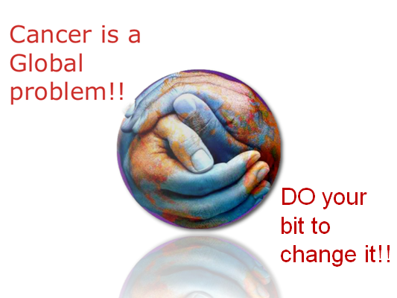

Slide 39

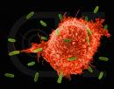
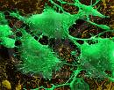



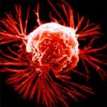
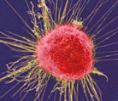


What is cancer?

Slide 40


